Slide 1
Brasília-DF, 05 de dezembro/22
Seminário Internacional Plataforma Clínica Global Covid-19 e Pós-Covid/ Organização Mundial da Saúde- OMS: Resultados da Pesquisa, Desafios e Lições Aprendidas
COLOMBIA
Carlos Arturo Alvarez-Moreno. MD; PhD
Coordinador Nacional estudios clínicos

Slide 2
Data workflow in the COVID and Postcovid Global Platform Projects.
Raw databases
Request information from systems/institutional contact. Validate delivery of information from systems/institutional contact.
Structured databases
Draw up data validation dictionary: semantic fields. Perform proof of concept against WHO standard. Validate data quality and take corrective actions. Feedback meetings, identifying data gaps.
Structured regional databases
Integrate database by institution to the WHO Global Platform. Validate data integration between data Test data quality

Slide 3
TOPICS
1
Plataforma Clínica Global COVID-19
2
POST COVID-19 Platform
3
Estudio EPICO

Slide 4
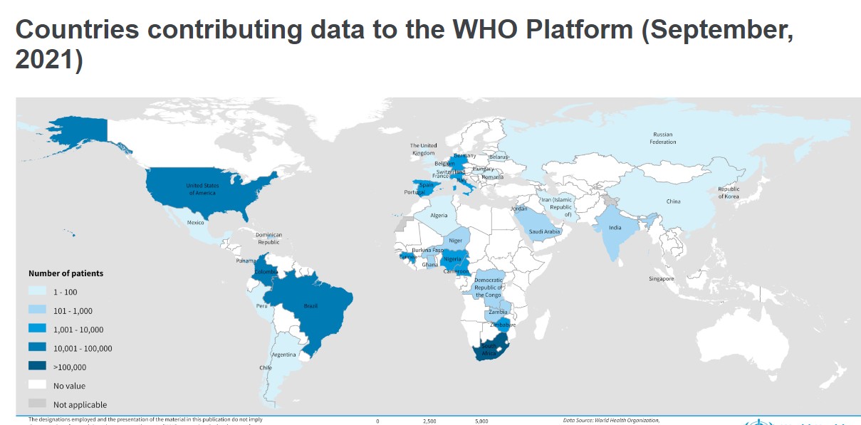
Clinical Trials Registry Platform
With the support of PAHO in Colombia and Washington, it was possible to quickly implement.

Slide 5
Plataforma Clínica Global COVID-19
Goal
To describe the key clinical features and prognostic factors of hospitalized cases of suspected or confirmed COVID-19, thereby increasing understanding of the severity, spectrum, and impact of the disease in the hospitalized population globally, in different countries.
Characterize clinical interventions, thus facilitating global and national operational planning during the COVID-19 pandemic.

Slide 6
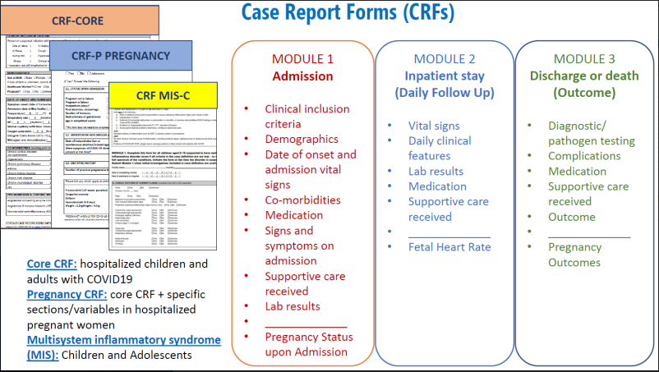
Plataforma Clínica Global COVID-19
Para armonizar la recopilación de datos en diversos entornos mundiales, la OMS ha desarrollado un formato estándar.
• Contiene un conjunto mínimo de variables clave y establece la base de tres tipos de CRF:
- CRF base
- CRF de embarazo
CRF multisystem inflammatory síndromeMIS-C
• Data can be recorded directly on the platformelectronically or in CRF printed on paper, then entering the dataon the WHO platform.
7 Feb 2020 - 11 Jun2021
Phase 1

Slide 7
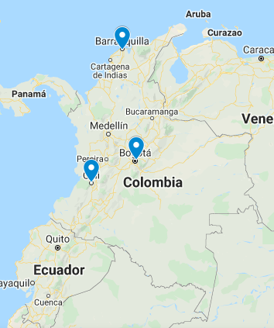
Plataforma Clínica Global COVID-19
Fundación Cardioinfantil, Bogotá
Clínica Infantil Colsubsidio, Bogotá
Hospital Universitario San Ignacio, Bogotá
Clínica Iberoamérica, Barranquilla
Clínica Colsanitas-Clínica Sebastián de Belalcázar, Cali
Hospital Militar Central, Bogotá
Hospital Universitario Nacional de Colombia, Bogotá
Clínica El Carmen, Barranquilla
Clínica Colsanitas - Clínica Reina Sofía, Bogotá
Clínica Colsanitas-Clínica Universitaria Colombia, Bogotá
Clínica Colsanitas-Clínica Infantil Santa María del Lago, Bogotá
2
8
1

Slide 8
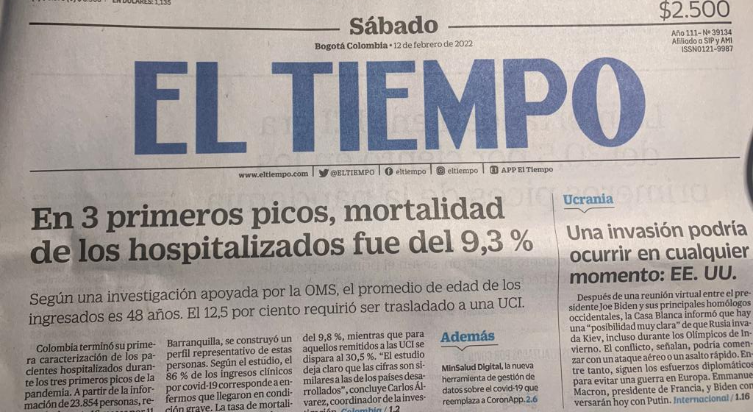
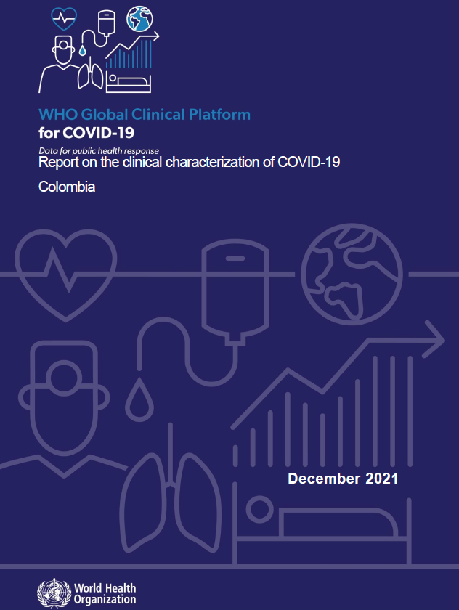
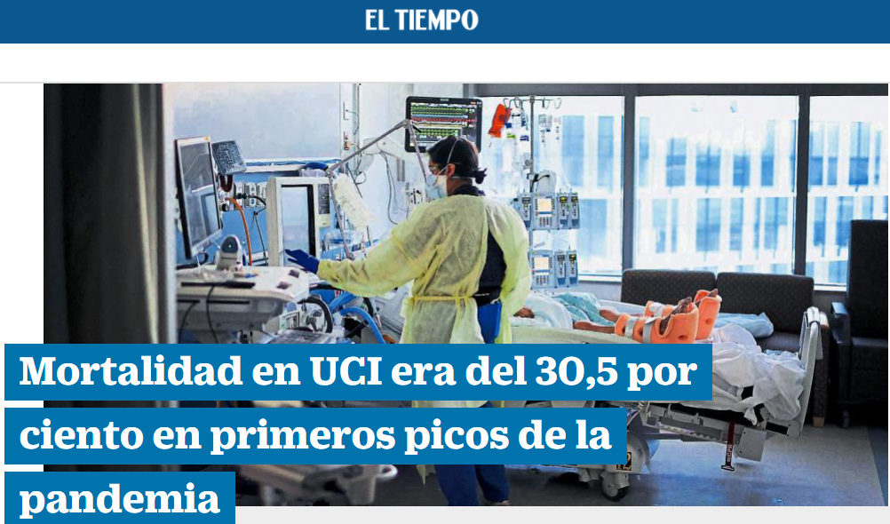
Gestión Científica y de Investigación
27.881 Registered Patients

Slide 9
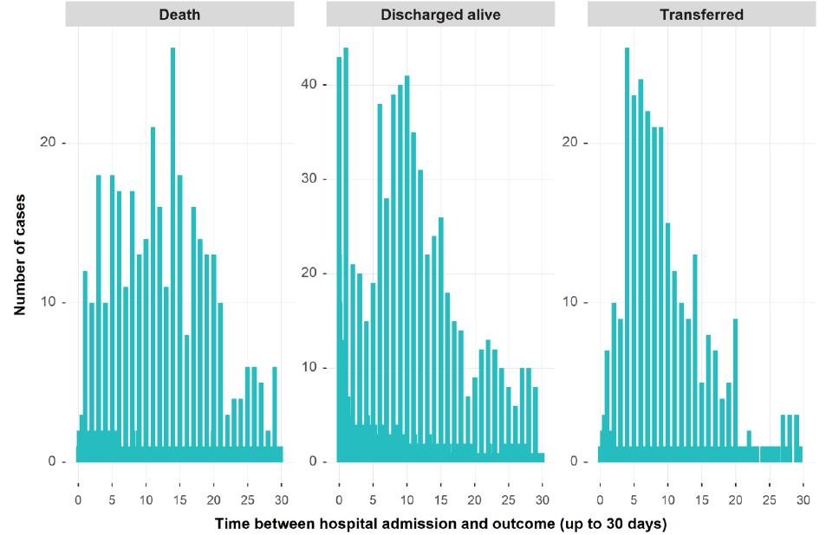
11.2
6.3
7.7

Slide 10
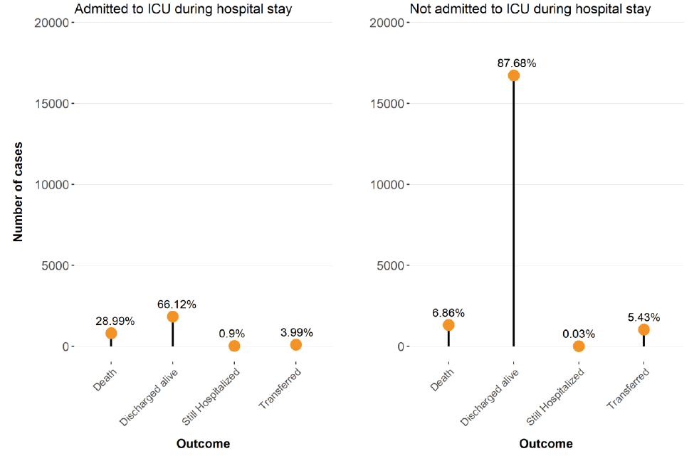
Gestión Científica y de Investigación
Proporción de resultados para pacientes con COVID-19 por nivel de atención hospitalaria recibida (UCI VS No UCI )

Slide 11
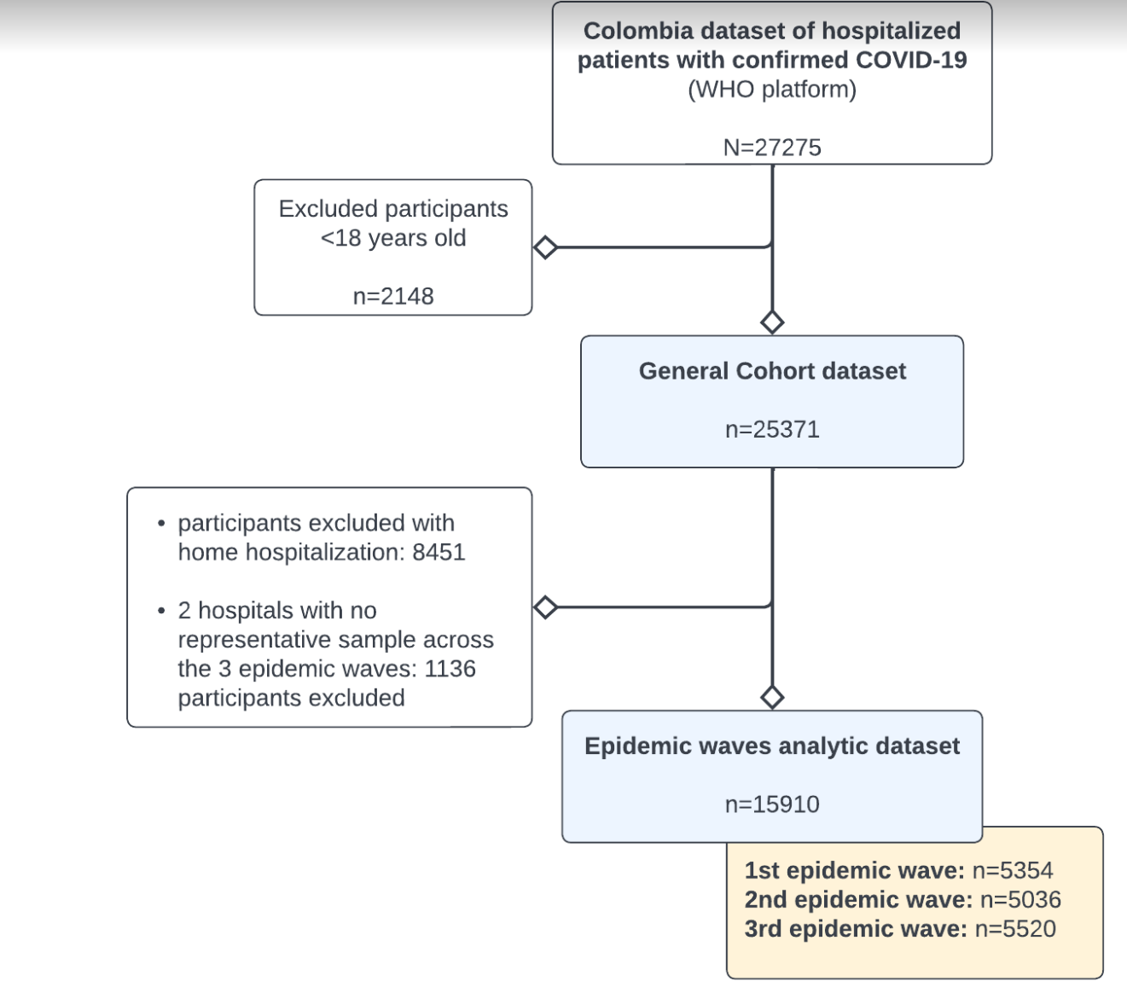
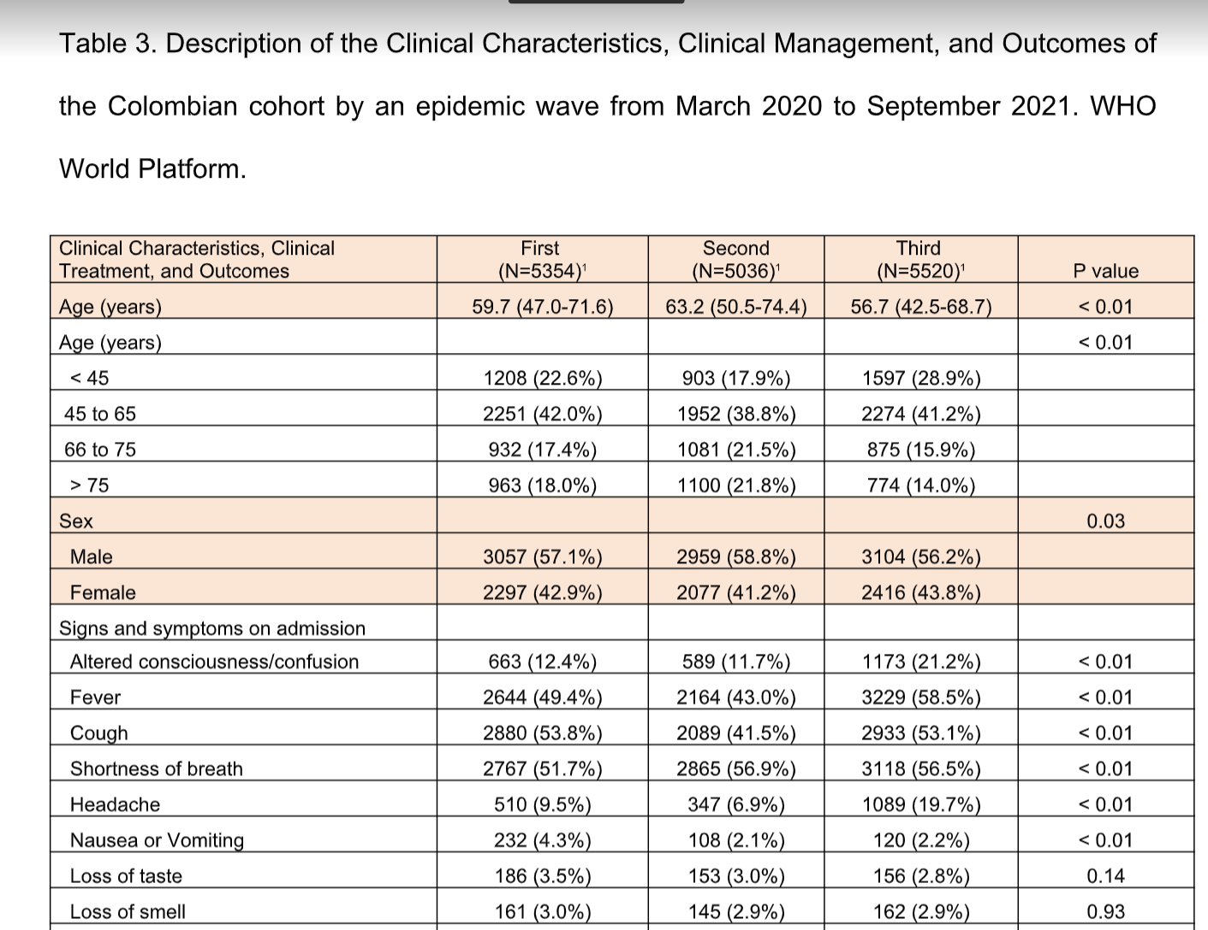
submitted for publication

Slide 12
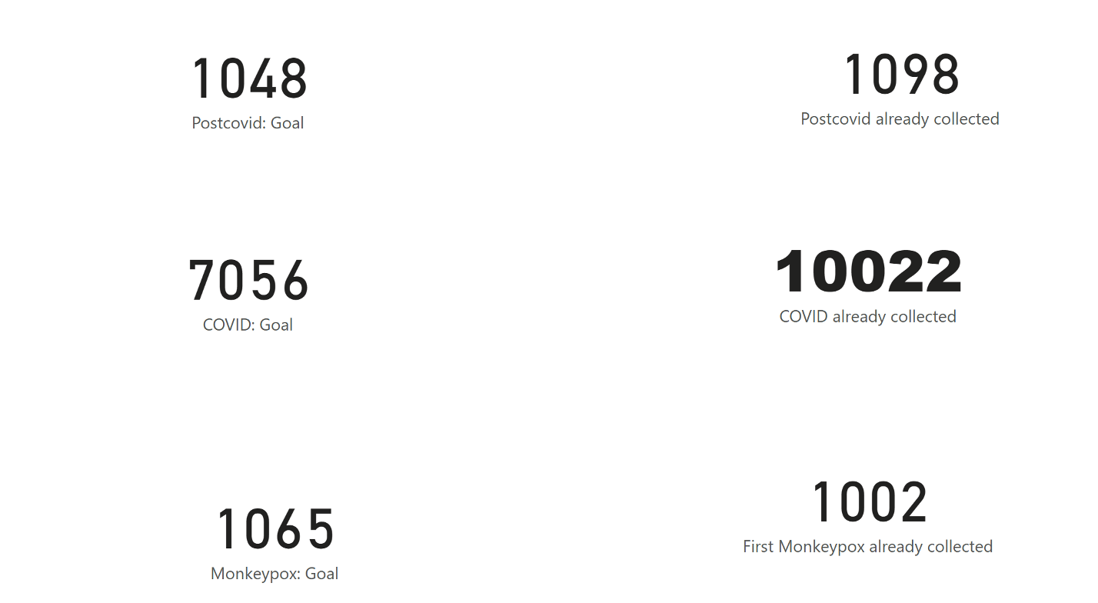
Apresentação
2022
Phase 2
Iniciativa Rede Colaborativa Brasil
Estudo de caracterização clínica e manejo de pacientes hospitalizados com Covid-19: contribuindo com o SUS e a Plataforma Clínica Global da OMS

Slide 13
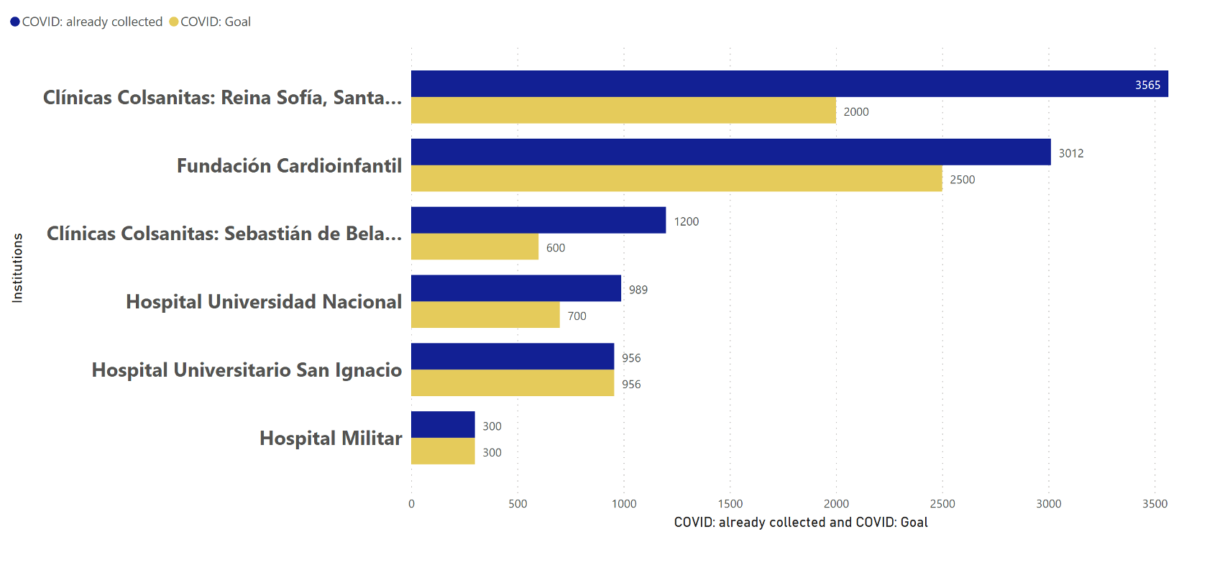
Apresentação
Iniciativa Rede Colaborativa Brasil
Estudo de caracterização clínica e manejo de pacientes hospitalizados com Covid-19: contribuindo com o SUS e a Plataforma Clínica Global da OMS

Slide 14
TOPICS
1
Plataforma Clínica Global COVID-19
2
POST COVID-19 Platform
3
Estudio EPICO

Slide 15
Plataforma Clínica Global COVID-19
Post COVID-19 Condition
Designed to assess the mid and long-term sequelae of COVID-19
CRF Post COVID-19 includes 3 modules:
Module 1: Acute COVID-19 episode. Clinical Record, demographics and symptoms related to the acute episode of COVID-19.
Module 2: Questions related to the period of post-acute illness to identify patients who require further clinical attention.
Module 3: Follow up. Includes the medical evaluation and the results of the examinations, tests or diagnoses made during the follow-up visit.
It can be a clinical tool to document the medium and long-term sequelae of COVID-19. This will ensure that rehabilitation needs are identified, and patients are provided with the care they need.

Slide 16
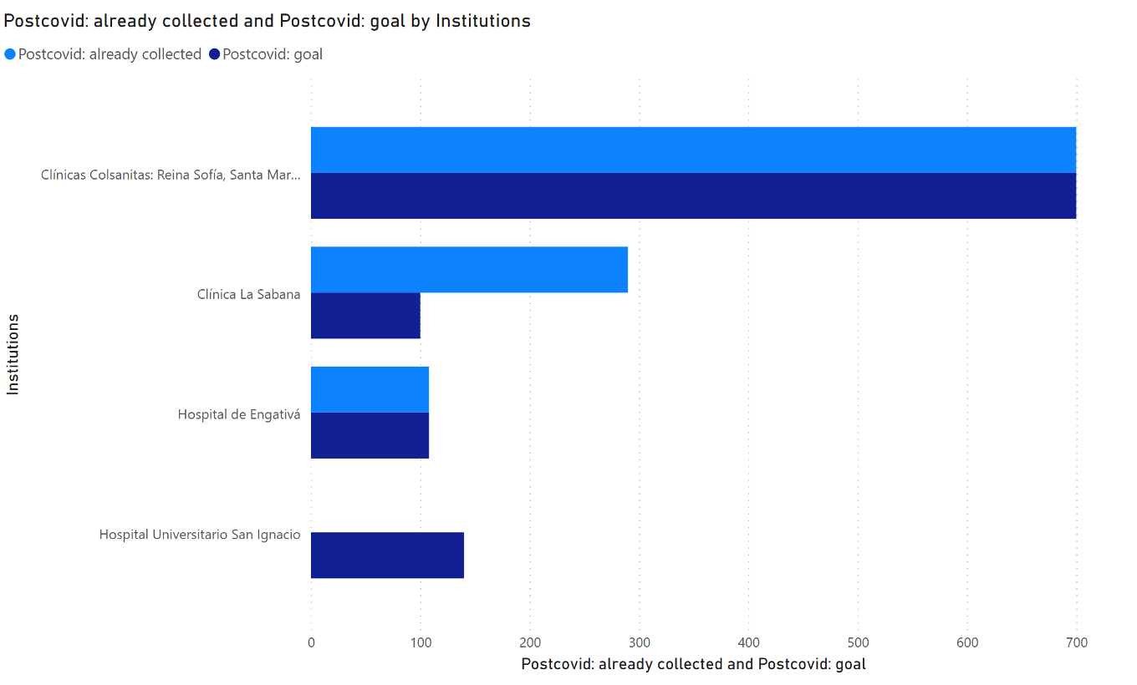
Apresentação
Iniciativa Rede Colaborativa Brasil
Estudo de caracterização clínica e manejo de pacientes hospitalizados com Covid-19: contribuindo com o SUS e a Plataforma Clínica Global da OMS

Slide 17
TOPICS
1
Plataforma Clínica Global COVID-19
2
Estudio POST COVID
3
EPICO

Slide 18
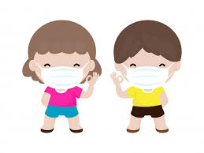
CORONAVIRUS (SARS-COV-2) IN PEDIATRIC POPULATION IN COLOMBIA: EPIC GROUP.

Slide 19
COLOMBIA CORE TEAM
Carlos Álvarez Moreno, MD. PhD
Clara Galvis, MD.
Iván Felipe Gutierrez, MD.
Mario Augusto Rojas, MD, MPH.
Martha Báez, MD.
Pablo Vasquez Hoyos, MD, MSc.
Sandra Beltran, MD.
Camilo Andrés Cristancho, MD,
Daniela Duarte Montero
Luis Miguel Navarro.
Oscar Ovalle, MD.
María lucía Mesa Rubio MD MsC
Andrea Ramírez MD PhD
Equipo multidisciplinario EPICO COLOMBIA
Diferentes especialidades, enfoque clínico y metodológico
Representación de diferentes Sociedades Científicas

Slide 20
OBJETIVES
To describe the spectrum of disease associated with confirmed SARS-CoV-2 infection that requires hospital management in the different areas of pediatrics, including its evolution, severity factors, and outcomes.
GENERAL PEDIATRICS
Newborn population

Slide 21
METHODS
Recolección información
Tipo de estudio
Red Cap: variables sociodemográficas, clinicas, evolució y desenlaces
Estudio observacional descriptivo, multicéntrico
Población
Menores 18 años (incluye neonatos) con infección confirmada por SARS CoV2.
159 Variables compartidas, 28 pediátricas y 61 neonatales exclusivas respectivamente
Tamaño de muestra
Se espera incluir el mayor número posible de cada uno de centros paricipantes (se estima por lo menos 200)
Seguimiento
Intrahospitalario, sin seguimiento ambulatorio
Duración
24 meses
Análisis estadístico
Limitaciones

Slide 22
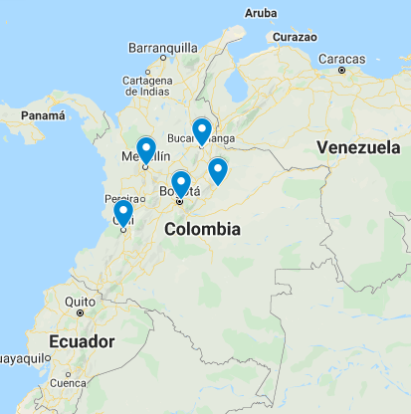
EPICO Colombia
Clínica Infantil Colsubsidio (CIC)
Hospital Regional de la Orinoquia
San José Centro
Clinica Materno Infantil San Luis
Instituto Roosevelt (IR)
Clínica Colsanitas Pediátrica
Clínica Colsanitas S.A. Sede Santa María del Lago
Hospital Militar
San José Infantil
Hospital Universitario Fundación Valle del Lili
Hospital Universitario Fundación Santa Fe de Bogotá (HUFSFB)
Clínica SOMA
Clínica del Rosario
1
2
1
8
1

Slide 23
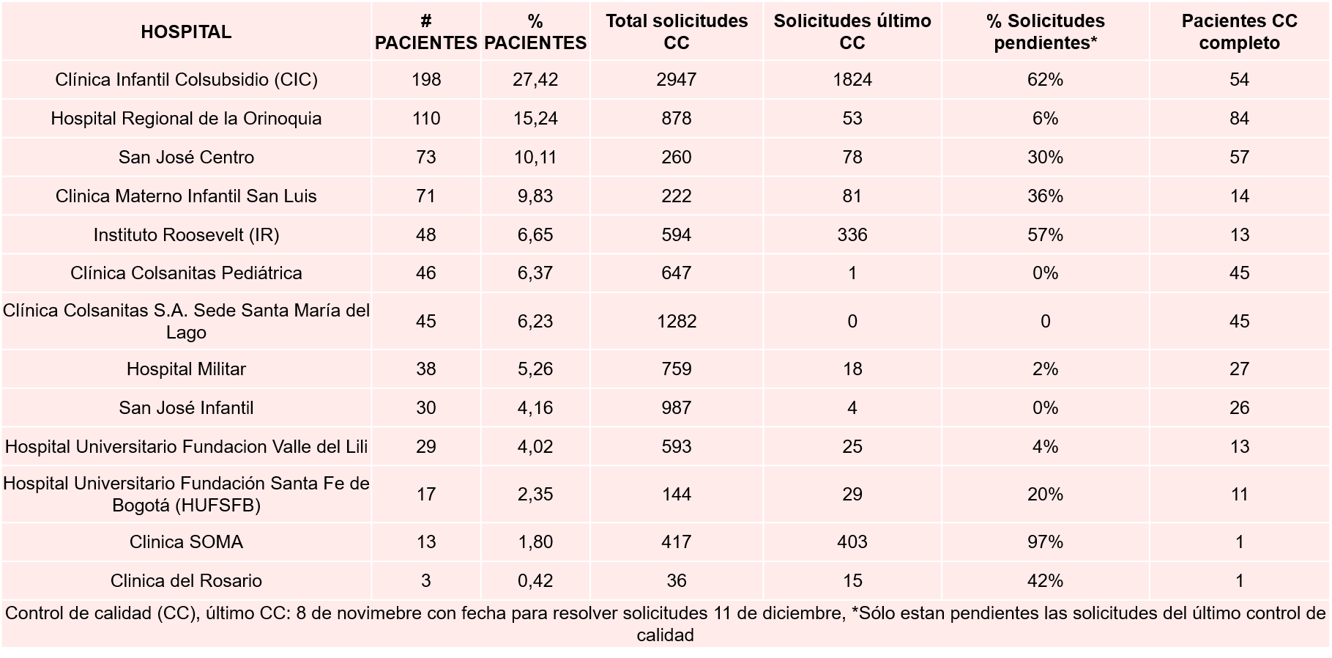
EPICO Colombia
Fecha de corte: 31 de diciembre 2021

Slide 24
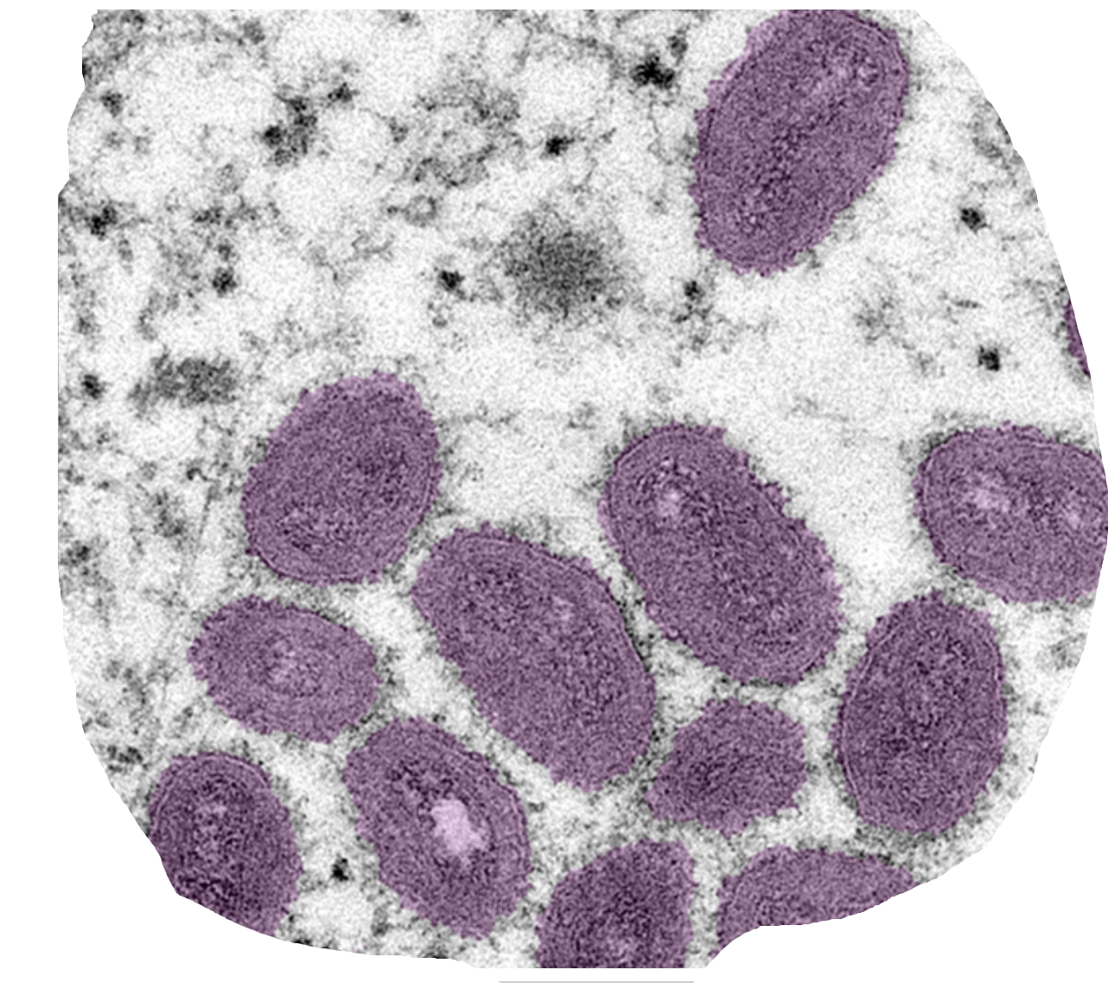
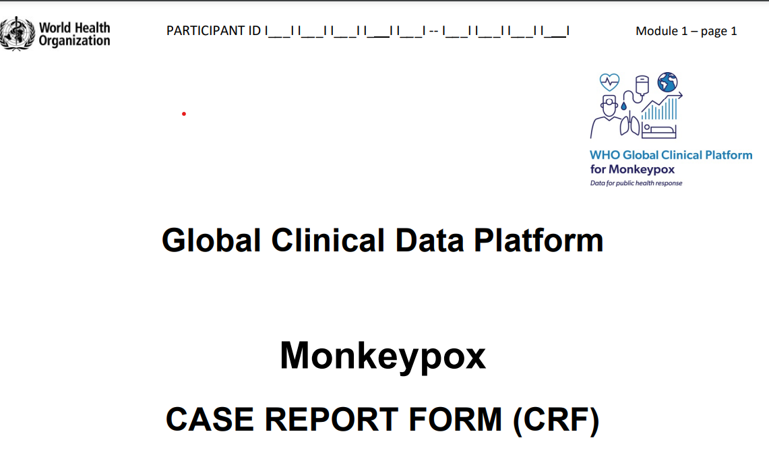
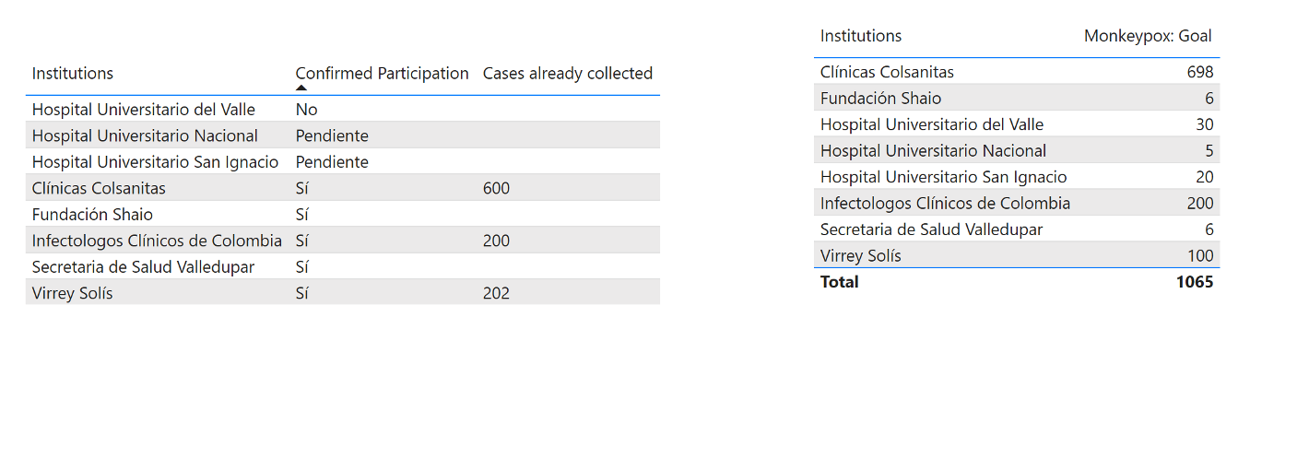
Apresentação
COLOMBIA
Iniciativa Rede Colaborativa Brasil
Estudo de caracterização clínica e manejo de pacientes hospitalizados com Covid-19: contribuindo com o SUS e a Plataforma Clínica Global da OMS

Slide 25
CHALLENGES
Emergency Rooms
ICUs
Laboratory services
Hospitals
MINSALUD/CENTRAL CORE/OPS
Big Data
Ethical Commitees
the administrative processes are being more difficult than expected
Research Centers
At the beginning, solidarity and resilience surpassed the bureaucracy, but...

Slide 26
NEEDS
More agile administrative processes, including ethical processes, but maintaining its seriousness.
Focal points for clinical and observational studies.
Big data handling capacity

Slide 27
Muito obrigado
@AlvarezMorenoC
caalvarezmo@unal.edu.co

